Slide 1
CSS3 Day2
Lesia and Natalia

Slide 2
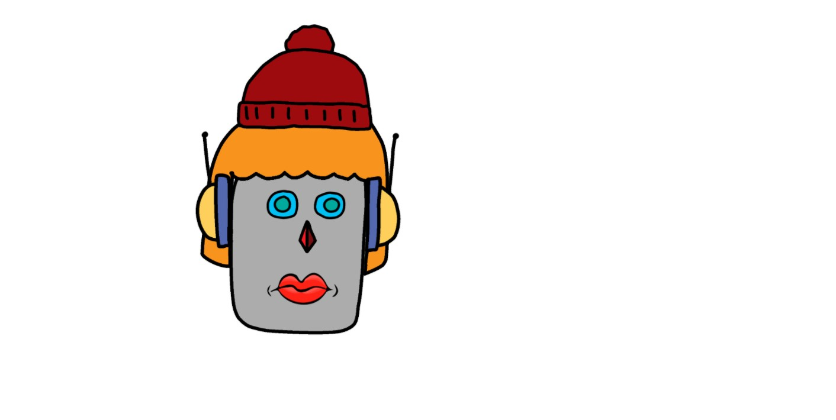
In browser

Slide 3
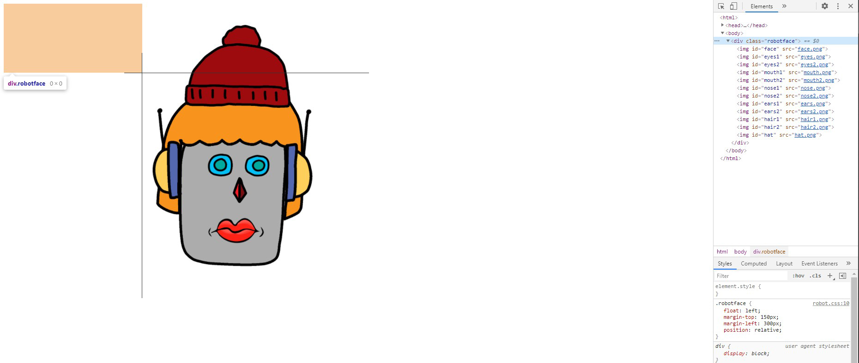
<div class“robotface“> is like a box for all images and has position: relative. The images have position: absolute, so they are located in relation to div parent
Left: 0;
Top: 0;

Slide 4
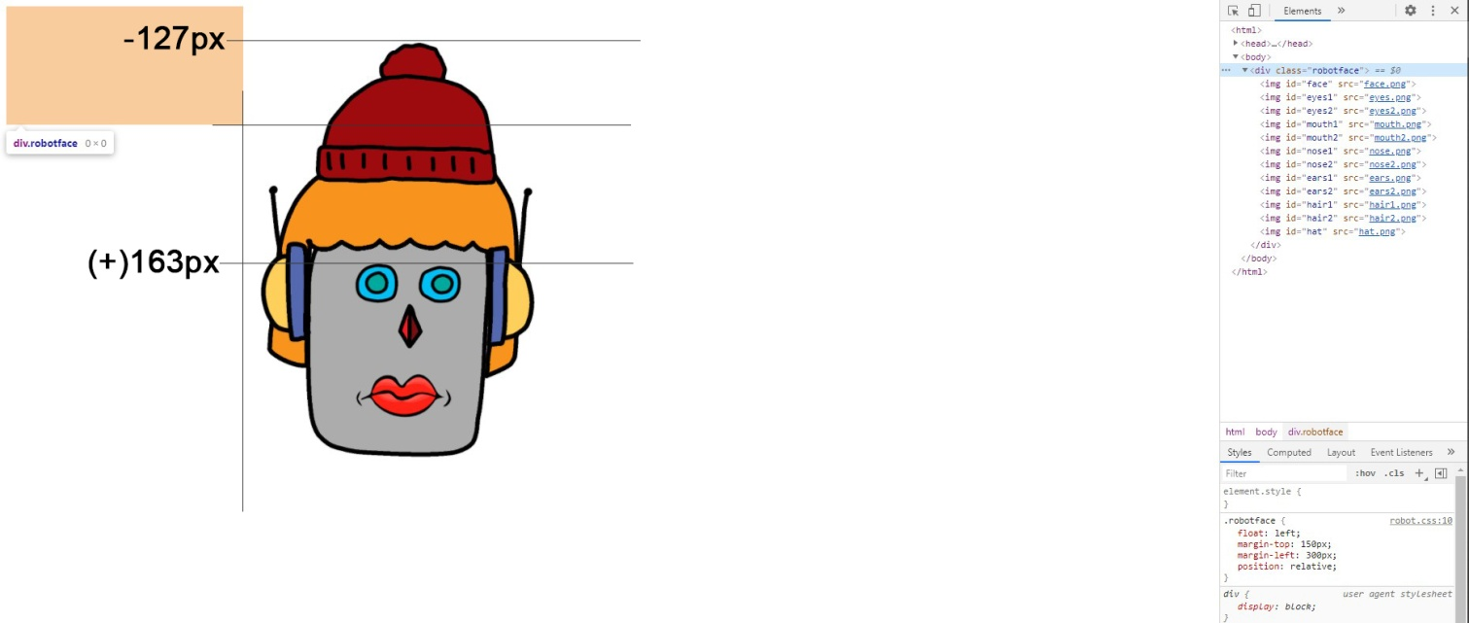
Here is an example of CSS code. I made in .robotface #hat top: -127px, because the hat is over the parent div
.robotface {
float: left;
margin-top: 150px;
margin-left: 300px;
position: relative;
}
.robotface #eyes1 {
top: 163px;
left: 131px;
width: 160px;
}
.robotface #hat {
top: -127px;
left: 77px;
width: 267px;
}

Slide 5
Sometimes it is useful to put on z-index (works only with position atribute).
By default .hair2 is above .ears1. With z-index I made it in reverse order
.robotface #ears1 {
top: 31px;
left: -16px;
width: 420px;
(by default z-index: 1;)
}
.robotface #hair2 {
top: 16px;
left: 13px;
width: 362px;
(by default z-index: 2;)
}
.robotface #ears1 {
top: 31px;
left: -16px;
width: 420px;
z-index: 2;
}
.robotface #hair2 {
top: 16px;
left: 13px;
width: 362px;
}

Slide 6
At the end, I made other elements hidden with display: none
.robotface #eyes2,
.robotface #mouth2,
.robotface #nose1,
.robotface #ears2,
.robotface #hair1 {
display: none;
}

Slide 7
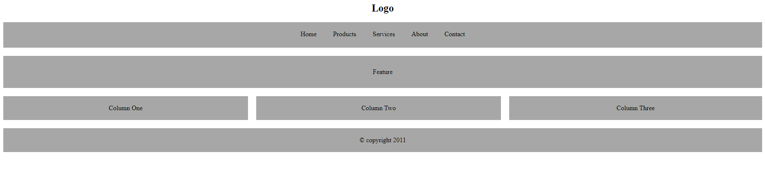
Advanced in browser

Slide 8
I used pseudo class last child to remove padding of last element
&copy; is copyright symbol
.box {
float: left;
width: 33.33%;
padding-right: 20px;
box-sizing: border-box;
margin-bottom: 20px;
}
.columns {
float: left;
width: 100%;
background-color: rgb(166, 167, 166);
padding: 20px 0;
box-sizing: border-box;
text-align: center;
}
.box:last-child {
padding-right: 0;
}
<div>
<div class="box">
<div class="columns">Column One</div>
</div>
<div class="box">
<div class="columns">Column Two</div>
</div>
<div class="box">
<div class="columns">Column Three</div>
</div>
</div>

